Slide 1
Vehicle Detection
Using Neural Networks
Batch no:31

Slide 2
OBJECTIVES:
Abstract
Introduction
Literature Survey
Objectives In Yolo
Methodology
Requirements
Algorithm
Merits And Demerits
Conclusion

Slide 3
ABSTRACT
A vehicle is any machine that transports people or cargo. Vehicle detection and vehicle type recognition is a practical application of machine learning concepts and is directly applicable for various operations in a traffic surveillance system contributing to an non-maximum suppression (post processing step for detecting the object) system. This will introduce the processing of automatic vehicle detection and recognition using static image datasets. Further using the same technique, we shall improvise vehicle detection by using YOLO algorithm. In previous algorithm (Faster RCNN) difficult to detect small objects.

Slide 4
Introduction:
“You Only Look Once” (YOLO) is a popular algorithm because it achieves high accuracy and also being able to run in real-time.
This algorithm “only looks once” at the image in the sense that it requires only one forward propagation pass through the network to make predictions.
The approach of YOLO is a frame by frame object detection.
The system divides the input image into an S×S grid and image content is predicted based on the bounding boxes of each grid cell.
To solve the problems of existing vehicle detection such as lack of vehicle-type recognition, low detection accuracy and slow speed, new vehicle detection models YoloV2, YoloV3, yolov4, YOLOV5 are introduced

Slide 5
Literature Survey:
Object detection plays an important role in computer vision, automatic vehicles, industrial automation etc. Detecting objects in real time is really a challenging task that too with more accuracy.
We required a large set of data to train the model, to find out the objects from given input. As per now in their official website we can find out various datasets to train our model.
In order to properly solve urban traffic problems and overcome the existing disadvantages, such
as the lack of enough vehicle information and the low accuracy of vehicle information retrieval,
intelligent transportation was strongly developed.

Slide 6
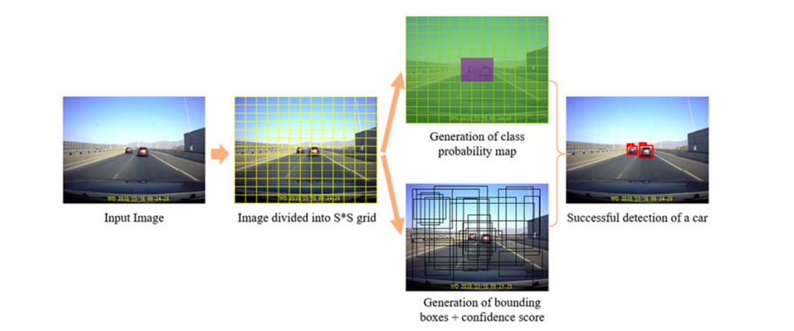
The algorithm structure of YOLOv7 is shown in below Figure. First a standardized image is used as input to the algorithm. Next the image is divided into S×S grids.
Then use these grids to generate class probability map, bounding boxes and confidence score. Finally, the object candidate box with confidence and location is actually output on the image
Figure1: Yolo Architecture/ Flow of object detection.

Slide 7

Objectives In Yolo:
YOLO algorithm can be used in autonomous cars to detect objects around cars such as vehicles, people, and parking signals. Object detection in autonomous cars is done to avoid collision mainly during night time.
This algorithm helps in detecting the vehicles and divide that into grid cells. Each grid cell is bounded with a bounding boxes and provides their confidence scores. The cells predict the class probabilities to establish the class of each object.

Slide 8
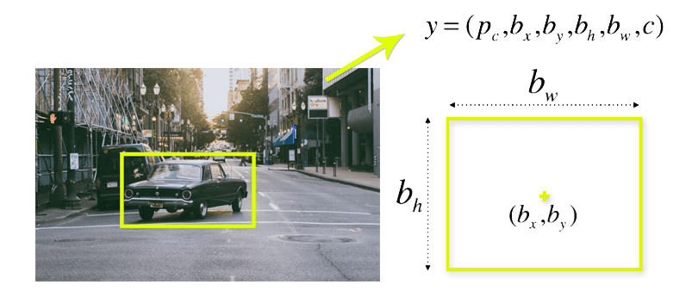
Methodology:
The input is a batch of images, and each image has the shape (m, 608, 608, c).
This yolo algorithm helps in detecting the vehicles and divide that into grid cells. Each grid cell forecasts B bounding boxes and provides their confidence scores. The cells predict the class probabilities to establish the class of each object.
The output is a list of bounding boxes along with the recognized classes.

Slide 9
confidence of an object being
present in the bounding box is 96%
bh, bw : height and width of the object present.
bx, by : Center coordinates of the object present if any
Car 0.96
b
b , b
h
x y
b
w

Slide 10
Algorithm Followed is:
Requirments:
HARDWARE:
Processor - 2 GHz or above
RAM – 4GB or above
Hard Disk – At least 1GB free
SOFTWARE:
Operating System – Mac OS
Python
Datasets
IOU - Intersection over Union,
Where:
IOU = Area of yellow box / Area of green box.
Step 1: Predict [Pc, bx, by, bw and bh] for all the grid objects.
Step 2: Discard where Pc≤0.6 (threshold). This is conditional discard with low probabilities.
Step 3: While there are remaining boxes:
Step 3.1: Pick the box with the largest Pc and output that as the prediction.
Step 3.2: Discard boxes (remaining) that have IOU≥0.5 with the output predicted in Step 3.2.
Step 3.3: Go back to Step 3

Slide 11

Merits and Demerits:
Process frames at the rate of 45 fps (larger network) to 150 fps(smaller network)
which is better than real-time.
One-shot object detection with great accuracy rate
Struggles to detect close objects because each grid can propose only 2 bounding boxes.
Struggles to detect hidden objects with more confidence

Slide 12
Conclusion:
YOLO is one of the best-known, most powerful object detection models, dubbed "You Only Look Once. With just One-shot we can detect object with great accuracy.
YOLO is the first option for every real-time identification of objects.
If we equip this in our vehicle then we would reduce the accidents rate at night time.
We need a large set of data to make this possible and train our model, to increase its success rate.
REFERENCES
https://ieeexplore.ieee.org/document/9326819

Slide 13
Thank You!

